Slide 1
Bootstrap Framework

Slide 2
INTRODUCTION
Bootstrap is an open – source front-end Frame-Work.
It is for Creating responsive websites and web applications.
Originally created by Twitter in 2011 → now maintained by open-source community
It Contains HTML, CSS and JavaScript.
Latest versions (Bootstrap 5+) focus on modern CSS
Mobile-first approach.
Single (responsive) grid system.
For More Info: getbootstrap.com

Slide 3
Importance Of Bootstrap
Rapid Development — build professional UI in minutes instead of days
Responsive by Default — powerful 12-column grid system + breakpoints
Pre-built Components — buttons, cards, navbars, modals, carousels, forms, alerts, etc.
Consistency — uniform look across pages & projects (great for teams)
Cross-browser Compatibility — well-tested across modern browsers
Customization — use Sass/SCSS variables, override classes, or use utility API
JavaScript Plugins — interactive elements (dropdowns, tooltips, offcanvas, etc.) included
Mobile-first approach + excellent documentation
For More Information:- https://www.w3schools.com/bootstrap

Slide 4
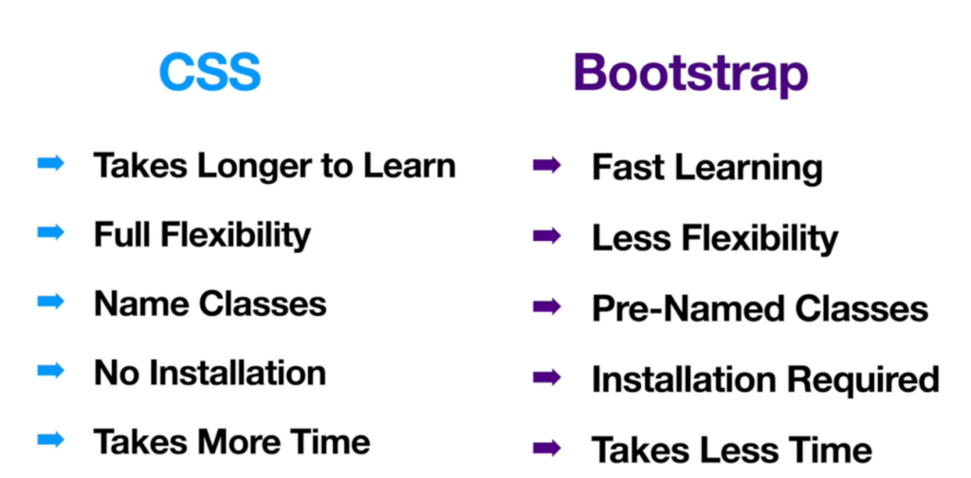
Bootstrap vs CSS

Slide 5
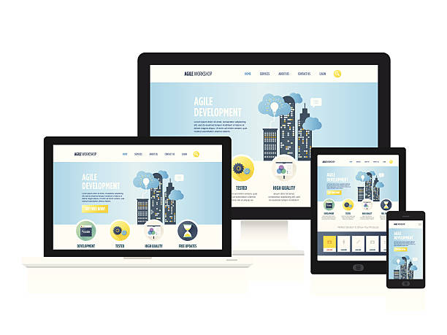
Responsive Design
The design that works properly on any resolution.
It majorly concerns with standard devices resolutions.
User friendly approach.

Slide 6
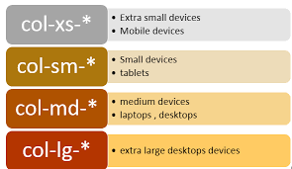
Responsive Design All Devices

Slide 7
Grid System
Bootstrap has a flexible grid system that works well on all devices, starting with mobile phones. It can expand up to 12 columns as the screen size gets bigger. It also has ready-made classes to help you design layouts easily.
The grid system helps you arrange your page by dividing it into rows and columns where you put your content.
The grid classes apply to devices with screen widths equal to or larger than certain sizes. For example, if you use a class for medium-sized screens (-md), it will also affect larger screens unless you add a class specifically for large screens (-lg-).

Slide 8
Grid Classes
Extra small devices i.e phones (<768px) symbol (-xs-), column width(Auto).
Small Devices i.e Tablets (≥768px) symbol (-sm-), column width(60px).
Medium Devices i.e Desktop (≥992px) symbol (-md-), column width(78px).
Large Devices i.e Desktop (≥1200px) symbol (-lg-), column width(95px).
Ex:- <div class="col-md-6"> Content </div>

Slide 9
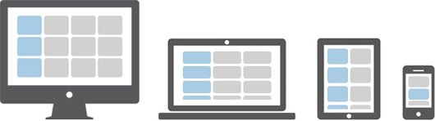
Bootstrap Grid System Example:

Slide 10
Bootstrap Typography
Bootstrap's typography system provides a consistent, readable, and modern foundation for text across websites and applications. It starts with sensible global defaults applied to <body> and <p> elements.

